Slide 1
Data Structures and Algorithm
Course Code: CS-201
Topic: Singly Linked deletion

Slide 2
Goals for today
To study:
Singly Linked List
Deletion

Slide 3
CLO Covered
CLO2: Apply and design various data structures methods for specified applications.

Slide 4
OPERATION ON SINGLE LINKED LIST
Deletion an element from the linked list
If the node be deleted, that element should be search all
over the list still the node find. Then it should be deleted.
As like as insertion the deletion is also performed in three ways.
Deletion at the beginning position of the linked list.
Deletion at the ending position of linked list.
Deletion at a specified position in linked list.
Notes:
4

Slide 5
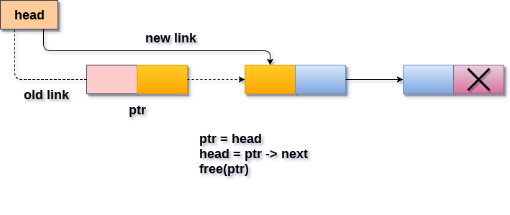
Deletion at beginning

Slide 6
Deletion at beginning
Step 1: If Start = Null then
Print: “linked list is already empty-Underflow”
Exit [End if]
Step 2: set Ptr = Start
Step 3:set Start = Start → Next
Step 4: free(Ptr)
Step 5:Exit

Slide 7
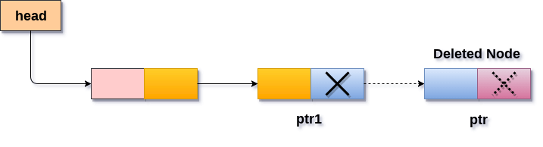
Deletion At end

Slide 8
Deletion At end
Step 1:If Start = Null Then
Print : “Linked List Empty”
Exit
[End If]
Step 2: set Ptr = Start
Step 3: Repeat steps 4 and 5 while Ptr →next != Null
Step 4: set temp = Ptr
Step 5: set Ptr = Ptr → next
[End loop]
Step 6: Set temp → next = Null
Step 7: free(Ptr)
Step 8: Exit

Slide 9
Deletion at the specified position
For deleting a particular node from the linked list, the first task is to find the address of the preceding node of nth node to be deleted.
To complete the task traverse the linked list from begin and compare the info. Stored in node with item.
Two pointers pointer1 pointer2 will be used while traversing the list for locating the address of the node to be deleted and address of it’s preceding node.

Slide 10
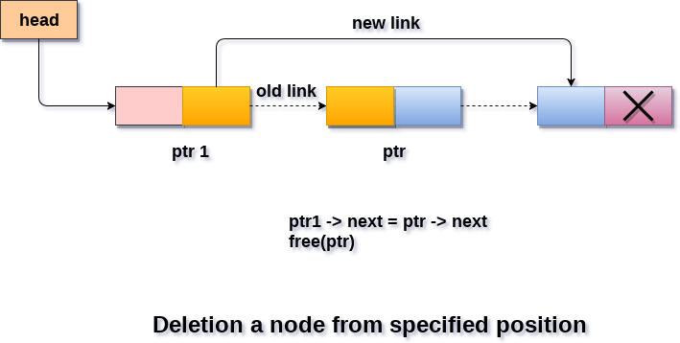
Deletion at the specified position

Slide 11
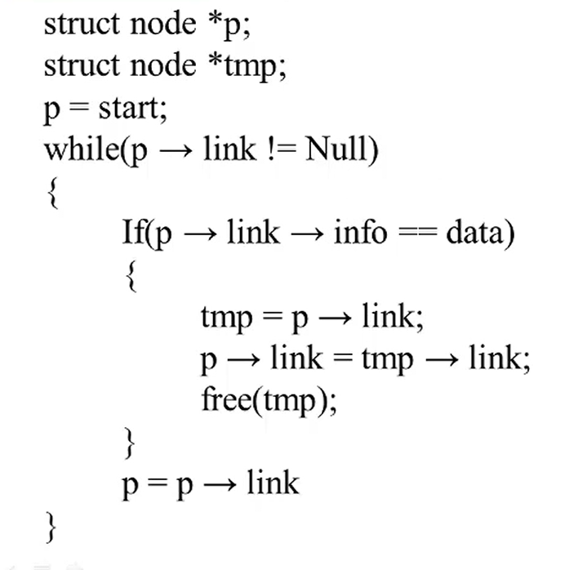
Deletion at the specified position

Slide 12
Questions?

